Slide 1

City Council meeting

Slide 2
Updates
Item | Notes
Raw water line | Going across the street starting Tuesday
Waste water treatment plant | Met with WWTP supervisor Stumma & Schwab regarding plans for upgrades – window of KDHE ‘loan forgiveness’
Bike trail | This project is close to being completed and projects look nice
Gym balcony | The upgrade to remove the chain link and replace with a plexi-glass looks fantastic
Muni grant | Watching for the grant for other building upgrades – expect it to open the middle of the month

Slide 3
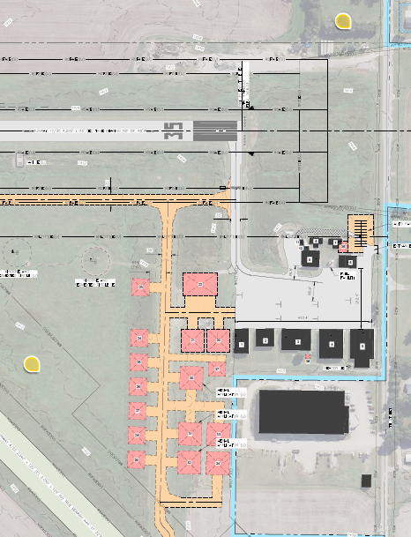
Airport
Hanger build is out for bid – estimated price would be $75,000 to not move forward with the build at this time
Concrete pads for loading
Temporary pads for loading

Slide 4
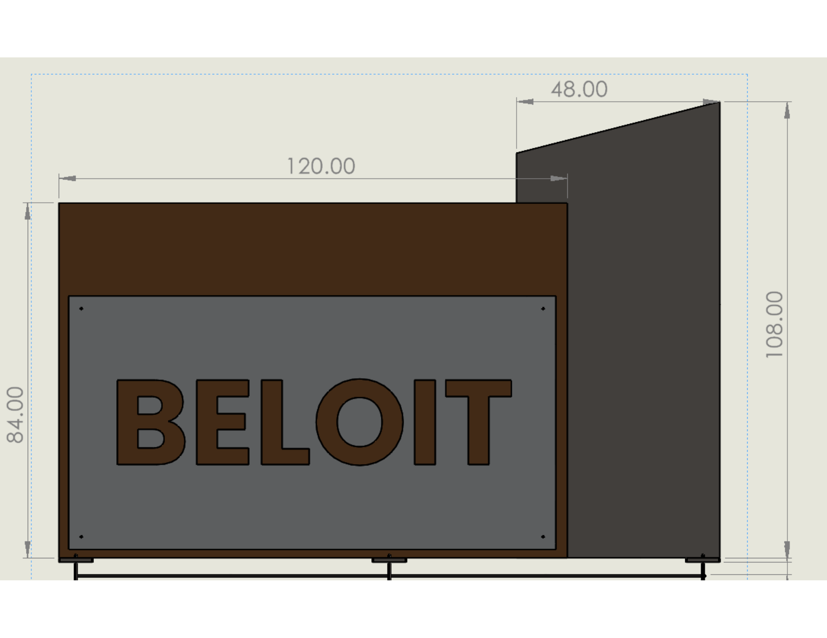
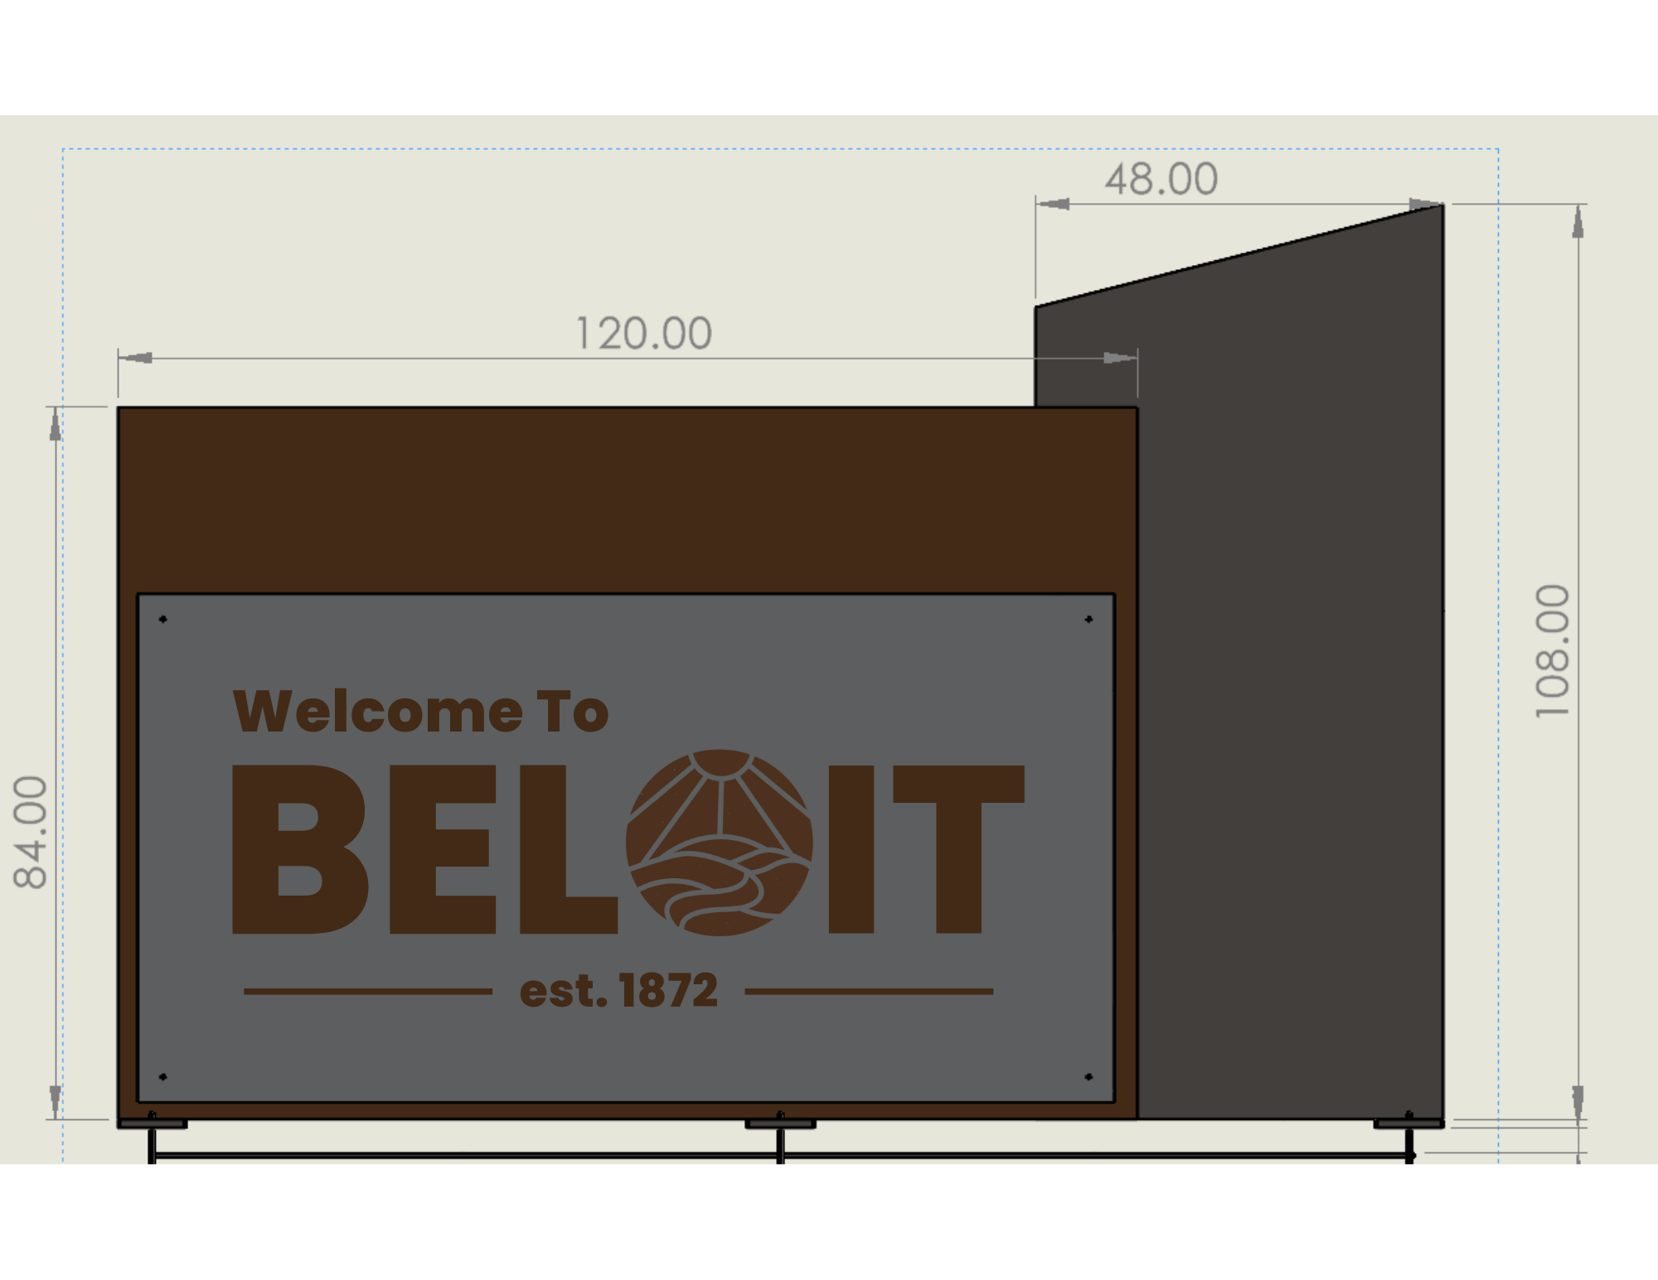
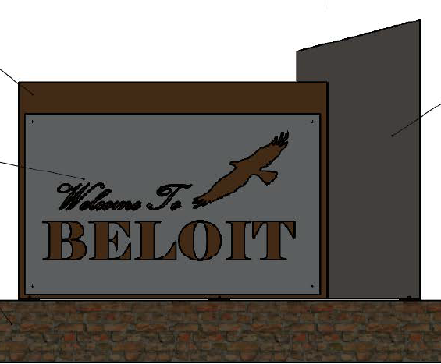
Welcome signs

Slide 5
WORK SESSION

Slide 6
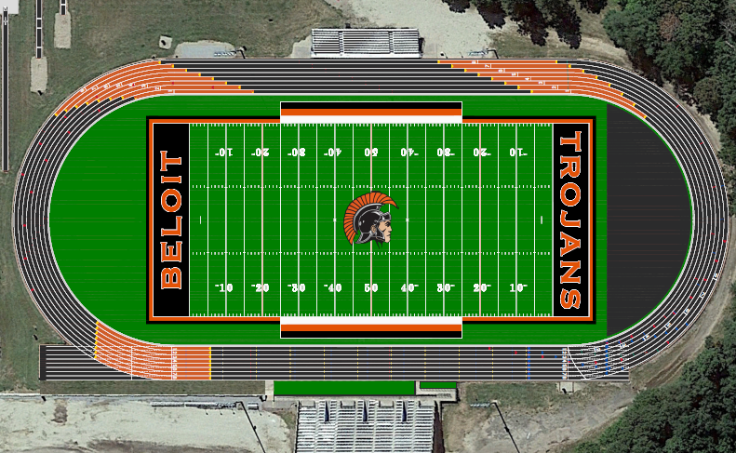
USD 273 track project
School track project
Financial support/sponsorship

